Slide 1
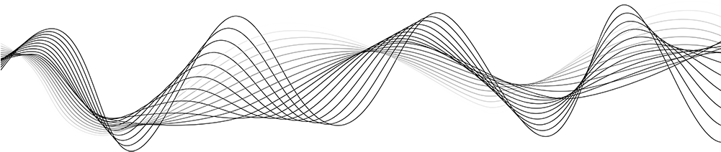
Audio classification using Artificial Neural Network

Slide 2
Project Outline
Introduction
Data Pre-processing
Model Training
Prediction

Slide 3
Introduction
Audio classification refers to the task of automatically categorizing audio data into different classes or categories based on their acoustic properties, content, or other relevant characteristics. It involves using machine learning techniques to analyze the audio signals and extract meaningful features to classify them into predefined classes.
Speech Recognition
Music Genre Classification
Sound Event Detection:
Emotion Recognition
Audio Scene Classification:
Anomaly Detection:

Slide 4
Machine Learning Process Overview
Data collection
Data preprocessing
Feature extraction
Data augmentation
Dataset splitting
Model selection
Model training
Hyperparameter tuning
Model evaluation
Model prediction
Model deployment

Slide 5
Supplementary data
Our data is downloaded from
https://urbansounddataset.weebly.com/download-urbansound8k.html
Data has total 8731 audio of 10 Classes.
dog_bark 1000
children_playing 1000
air_conditioner 1000
street_music 1000
engine_idling 1000
jackhammer 1000
drilling 1000
siren 929
car_horn 429
gun_shot 374

Slide 6

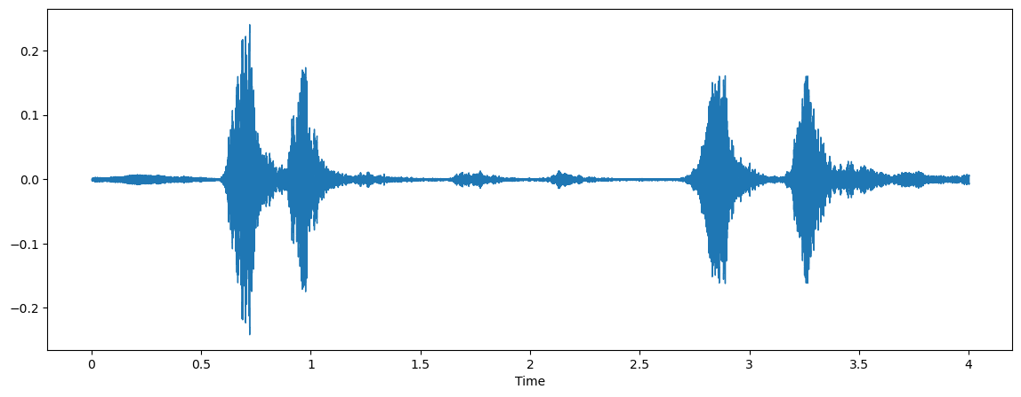
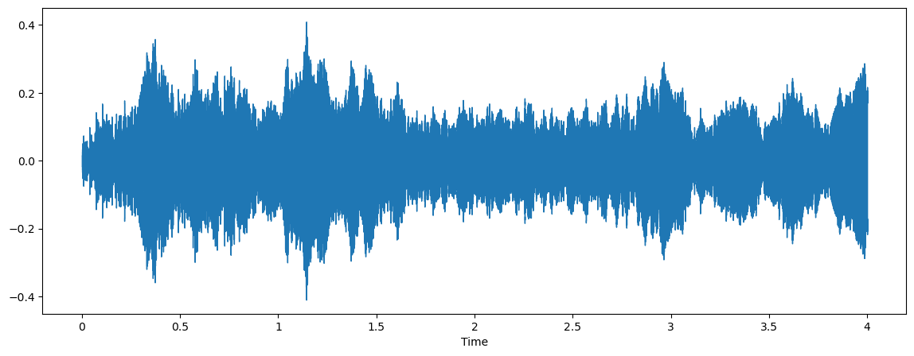
Example
Our audio file looks like this

Slide 7
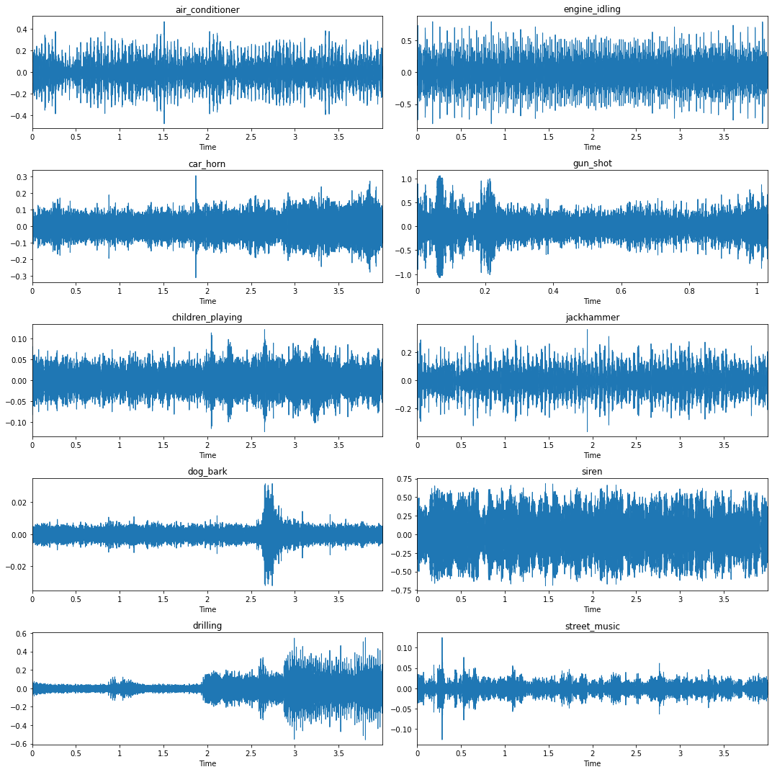
Audio Frequencies of 10 classes

Slide 8
Data pre-processing
Mel-frequency cepstral coefficients(MFCC)
Windows
A/D
Conversion
Preemphasis

DFT
Mel
filterbank
Energy
log( )
Feature Transform
Dynamic features
IDFT

Slide 9
Preemphasis filter is applied audio signal to emphasize higher frequency
In Windowing each frame is multiplied by a window function
A/D conversion stands for analog to digital conversion
DFT will convert the signal from the time domain to the frequency domain by applying the dft transform
Mel-frequency cepstral coefficients (MFCC)
In IDFT, we are doing the inverse transform of the output from the previous step.
Dynamic feature are particularly relevant when dealing with time series data.
Mel-filterbank is perceptual scale that better represent the human auditory system
Applying log to the output of mel-filter to mimic the human hearing system

Slide 10
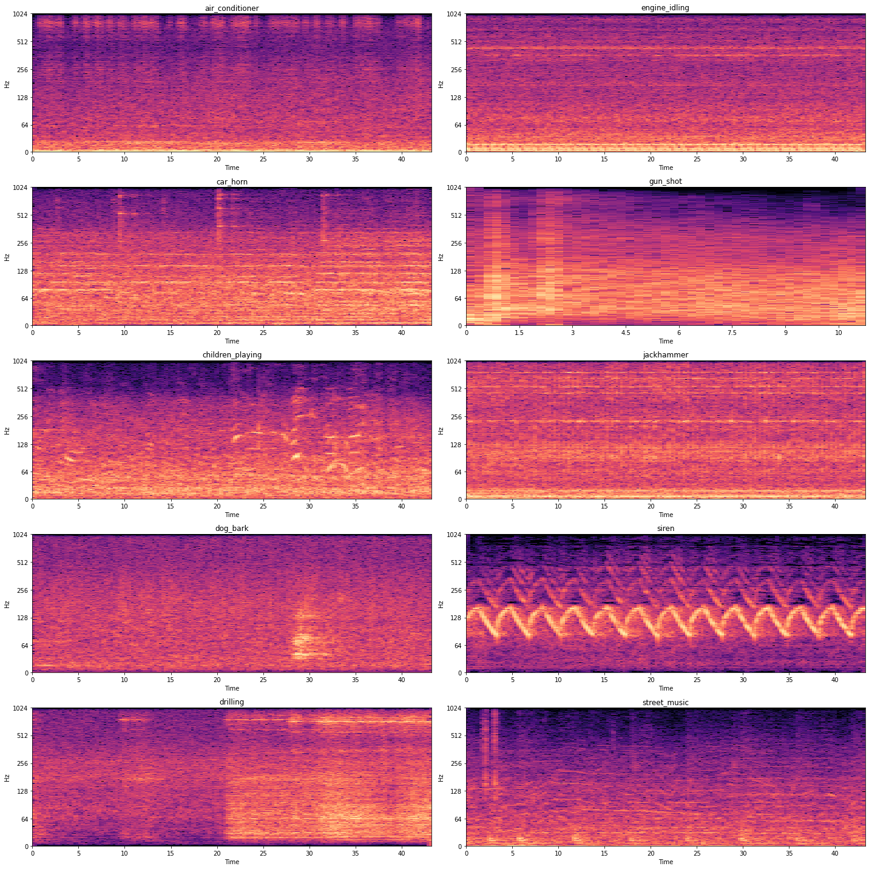
First Our Audio Frequency converted into log y Scale then Mel- spectrogram
Mel Spectrogram is nothing but an audio spectrogram with a Mel scale
Mel- spectrogram

Slide 11
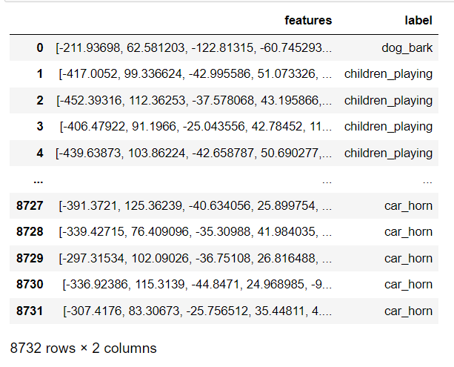
Different Class label and extracted features

Slide 12
How To Select Number of Neurons and Number of hidden Layer in ANN
There is no one-size-fits-all approach.
Number of neurons in the input layer should match the number of features in the dataset.
Number of neurons in the output layer should correspond to the number of output classes.
Number of hidden layer depending on the problem(we can check cross validation, overfitting )

Slide 13
Detecting Over Fitting
High training accuracy, low validation accuracy
Increasing or high variance in validation/test performance
Significant difference between training and validation/test performance
Overly complex model architecture
Visualizing loss and accuracy curves

Slide 14
Model training
We are using ANN with
Input layer: 40 neurons
Hidden layer: 4 hidden layer with each 500 neurons
Output layer 10 neurons

Slide 15
Layout of ANN
x1
1
1
1
1
2
2
2
x2
2
3
3
3
3
x3
x40
500
500
500
500
Hidden Layer
Output Layer
Input Layer

Slide 16
Model: "sequential"
_________________________________________________________________
Layer (type) Output Shape Param #
=================================================================
dense (Dense) (None, 500) 20500
activation (Activation) (None, 500) 0
dropout (Dropout) (None, 500) 0
dense_1 (Dense) (None, 500) 250500
activation_1 (Activation) (None, 500) 0
dropout_1 (Dropout) (None, 500) 0
dense_2 (Dense) (None, 500) 250500
activation_2 (Activation) (None, 500) 0
dropout_2 (Dropout) (None, 500) 0
dense_3 (Dense) (None, 500) 250500
activation_3 (Activation) (None, 500) 0
dropout_3 (Dropout) (None, 500) 0
flatten (Flatten) (None, 500) 0
dense_4 (Dense) (None, 10) 5010
activation_4 (Activation) (None, 10) 0
=================================================================
Total params: 777,010
Trainable params: 777,010
Non-trainable params: 0

Slide 17
Accuracy Of Our Model
After training the model our model accuracy is 87.7504 %
87.7504% indicates that the model is correctly predicting the outcome for approximately 87.7504% of the instances in the dataset.
High accuracy suggesting that the model is performing well.

Slide 18
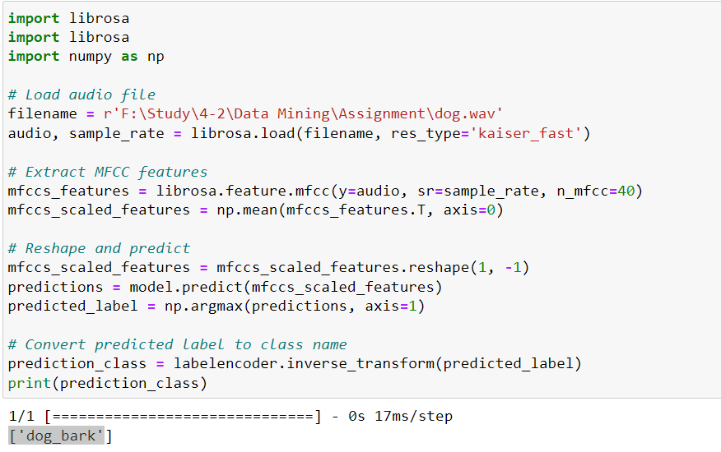
Prediction

Slide 19
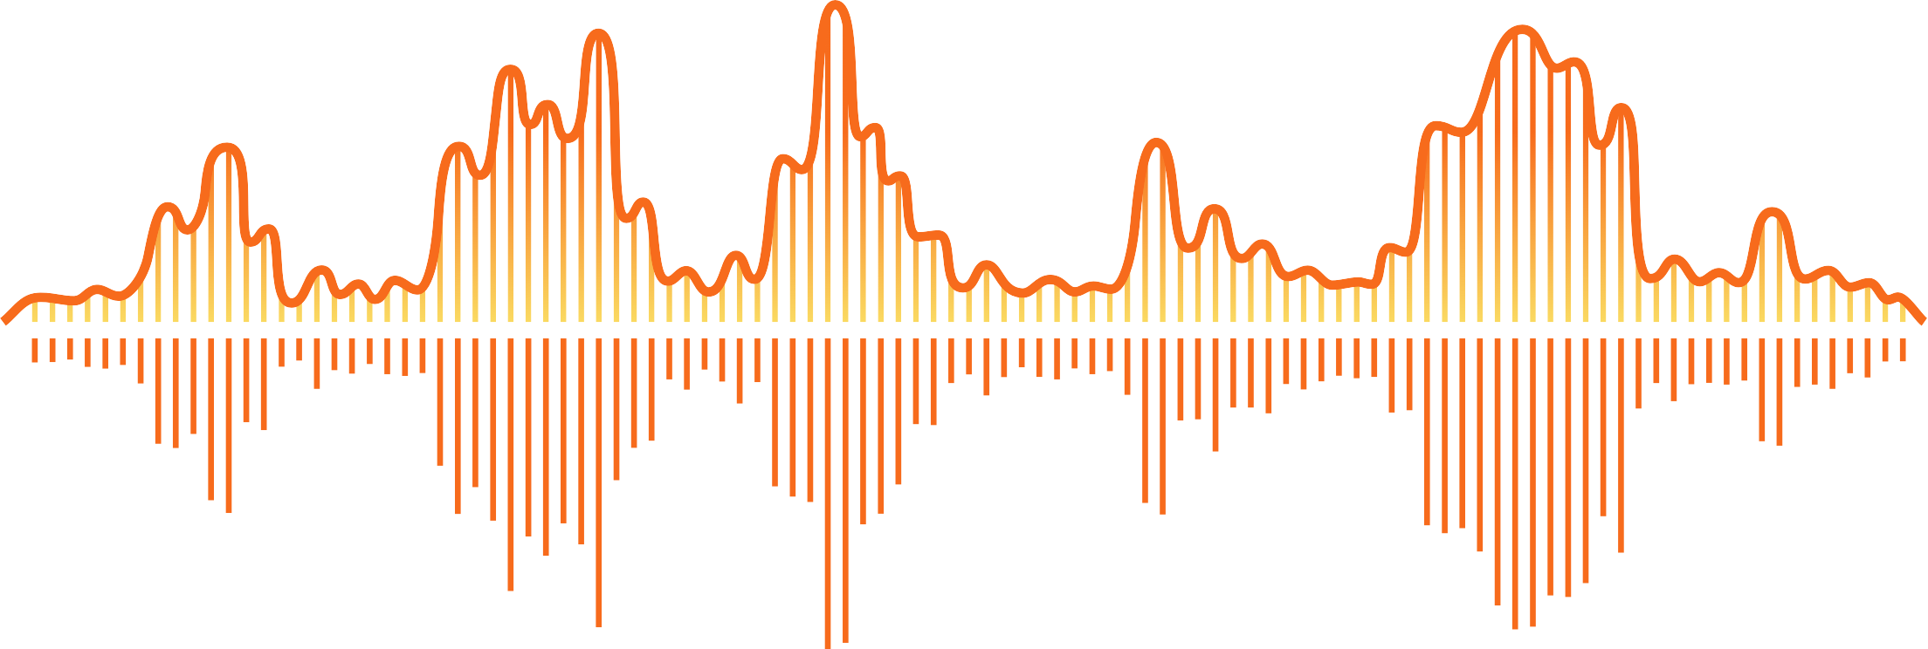
Thank you for being with us

